Slide 1
EDD 2018
IoT Platforms

Slide 2

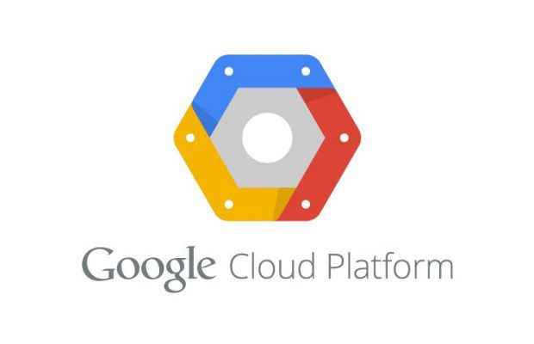


Overview Internet of Things platforms 2018
Interested in IoT but do not know the available options? Come with us in a journey across the most relevant IoT platforms from the big ones: Amazon, Google & Microsoft.
We will do a review of the following platforms:
Amazon AWS IoT
Google Cloud IoT Core
Microsoft Azure IoT
Capabilities, architecture, devices, day to day applications, possibilities, practical demonstrations…
Do not miss the next Internet evolution, stay tuned to IoT revolution!
Víctor Pérez
Hernán Bartoletti
Jaime Bohigas

Slide 3
Google IoT Services

Slide 4



- Internet of Things Services
Roadmap
Overview
Definitions & components interactions
Step by Step Configuration
Communications
Conclusion
Links & References
Practical Example

Slide 5

Google IoT Services
Overview

Slide 6
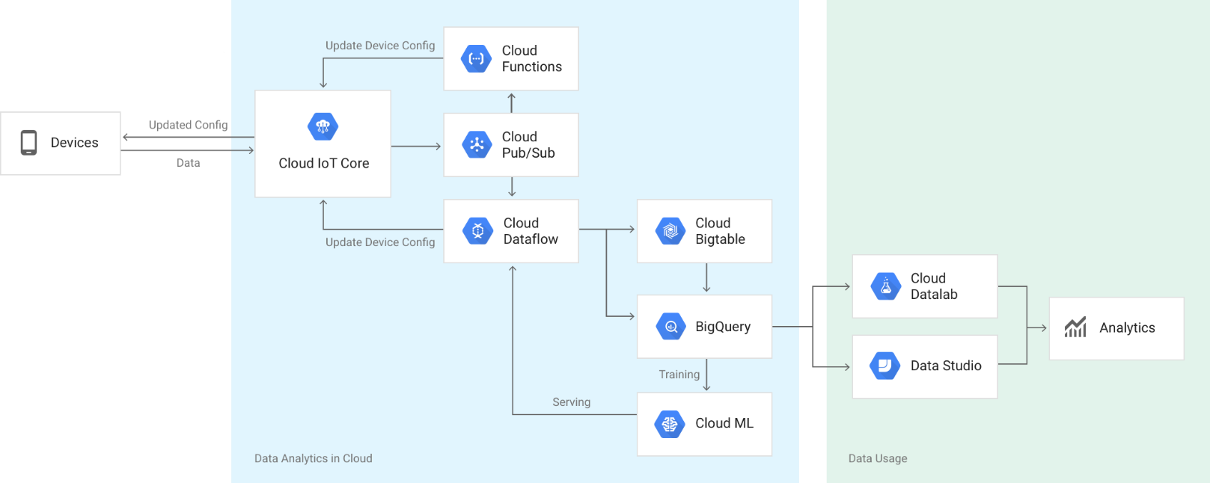
- Internet of Things Services
Components Overview

Slide 7
Google IoT Services
Definitions and Interactions

Slide 8








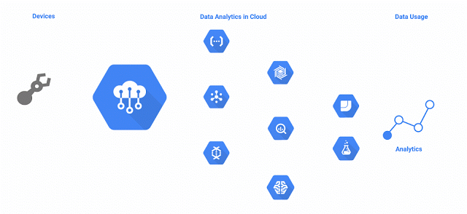
Google Cloud IoT Core
Definitions Interactions
Device Registries
Define Protocol
Define Pub/Sub Topics
Telemetry
Device State/Config topics
Devices
Device1..N
Device-ID
Communication
Authentication
Metadata
With the Devices
Cloud Pub/Sub
Cloud Dataflow (cfg)
Cloud Functions (cfg)

Slide 9
Google Cloud IoT Core
Communication with Devices (MQTT)
Security
Authentication using asymmetric cryptography (RS256 / ES256)
JWT signed with PK ( i.e.: jwtget )
Publish to:
Telemetry topics ( /devices/{dev-id}/events[/subtopic] )
Status topic ( /devices/{dev-id}/state )
Subscribe to:
Config topic ( /devices/{dev-id}/config )

Slide 10
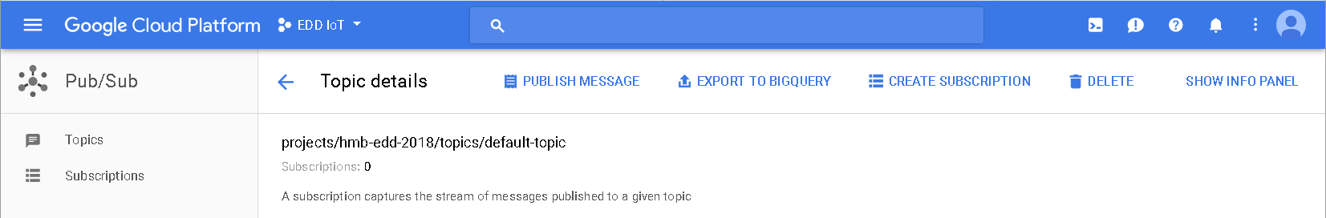
Google Cloud IoT Core
Cloud Pub/Sub
View/Update/Delete GCP Topics/Subscription
Publish Messages
Connect to different components

Slide 11



Google Cloud IoT Core
Cloud Dataflow
Need to activate the Storage Service [ ] / create a bucket
Neet to enable the Compute Engine API [ ]
Flow Jobs
Cloud PubSub to Cloud PubSub
IN subscription
OUT topic
Cloud PubSub to GCS Text
IN topic
OUT directory ( gs://{bucket-name}/{path} )
OUT file prefix & [suffix]
TMP location ( gs://{bucket-name}/{tmp-path} )
PubSub to BigQuery
Need to create a BigQuery table [ ]
IN topic
BigQuery OUT Table ({project}:{dataset}.table)
TMP location (gs://{bucket-name}/{tmp-path})
{
“key1": "value1",
"key2": "value2",
"key3": "value3“
}
key1 | key2 | Key3
value1 | value2 | value3

Slide 12
Google Cloud IoT Core
Cloud Functions
Programmed in node.js
Functions
Memory Allocated
Trigger
HTTP
Cloud Pub/Sub topic
Cloud Storage bucket event
Source code
Index.js
Package.json
Function to execute

Slide 13
Google IoT Services
Step by step Configuration

Slide 14
Google Cloud IoT Core
First Steps Service Administration
Sign in(up) [https://cloud.google.com/iot-core/]
Create a Project [https://console.cloud.google.com/cloud-resource-manager]
Enable Billing / Must add and associate a credit card [https://console.cloud.google.com/billing/
Enable IoT Core API [https://console.cloud.google.com/iot/]
WEB: Console [https://console.cloud.google.com/]
CLI: GCloud [https://cloud.google.com/sdk/docs/]
Client API: [https://cloud.google.com/iot/docs/reference/]
C# - Go - Java - Node.js - Python – Ruby (previously install https://cloud.google.com/apis/docs/cloud-client-libraries )

Slide 15
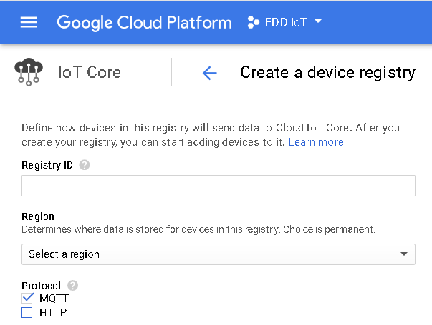
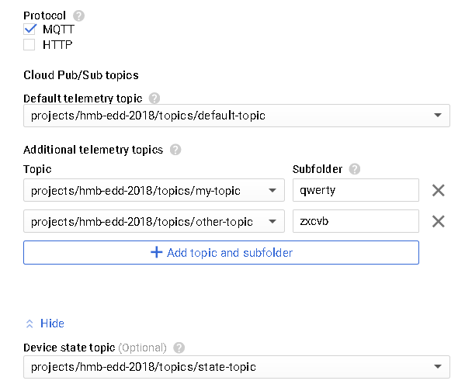
Google Cloud IoT Core
Configuration – Creating Device Registry
MQTT topic = /devices/{device-id}/events
MQTT topic = /devices/{device-id}/events/qwerty
MQTT topic = /devices/{device-id}/state

Slide 16
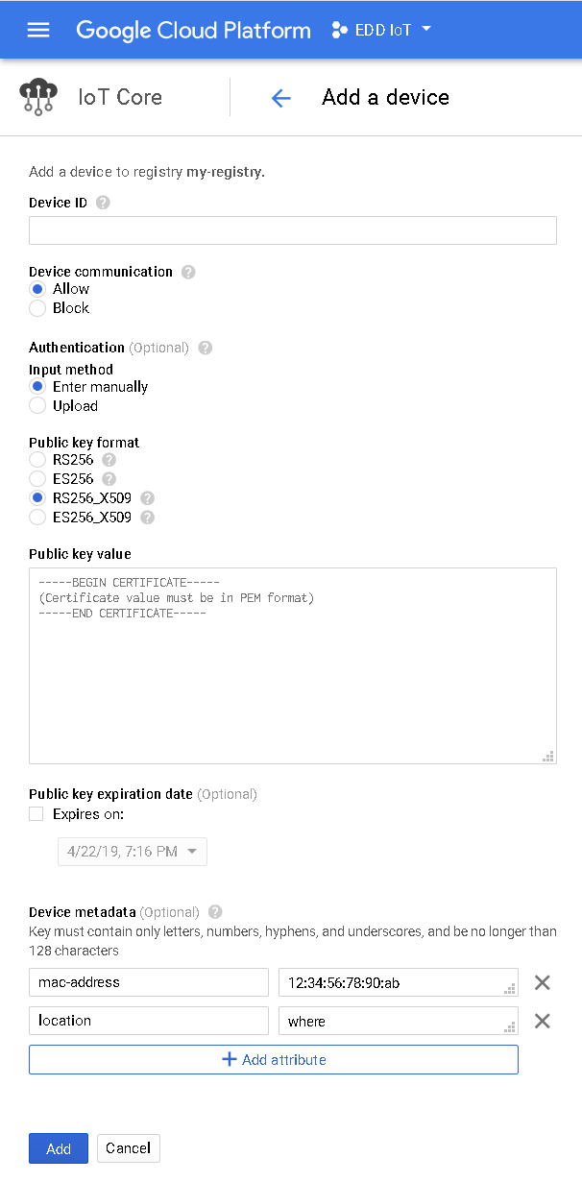
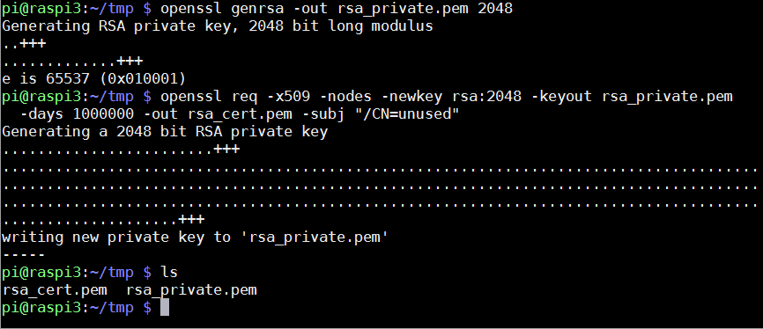
Google Cloud IoT Core
Configuration – Creating Devices
Place the content here
Persistent data stored in the server

Slide 17
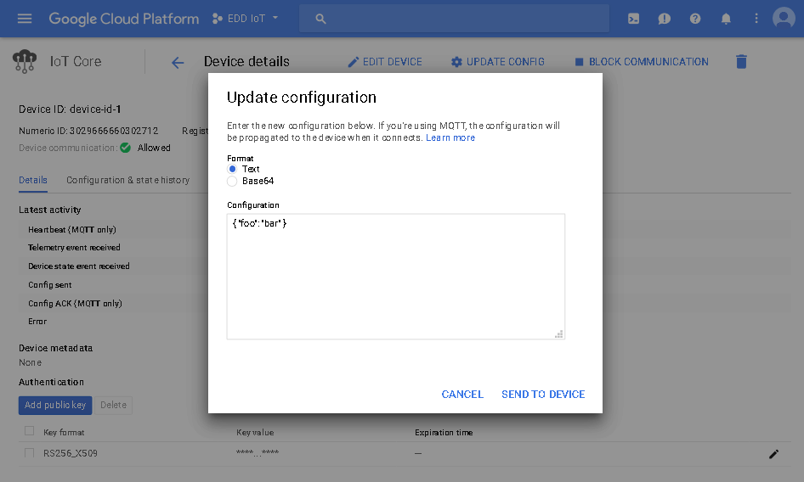
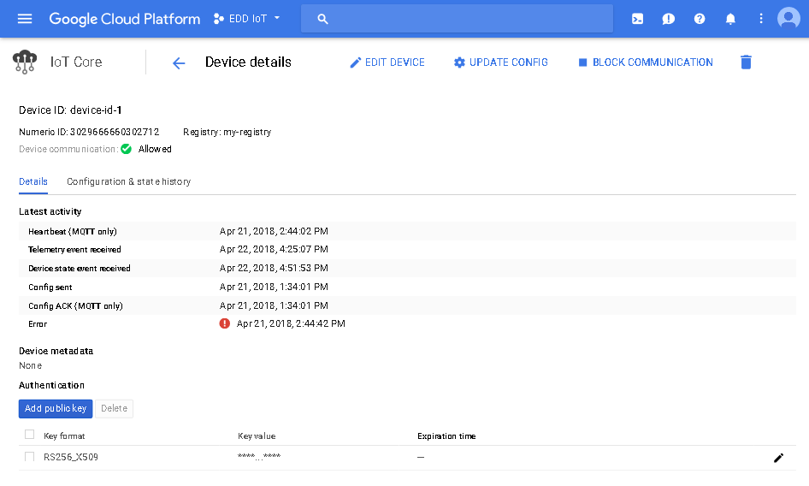
Google Cloud IoT Core
Configuration – Device Configuration

Slide 18
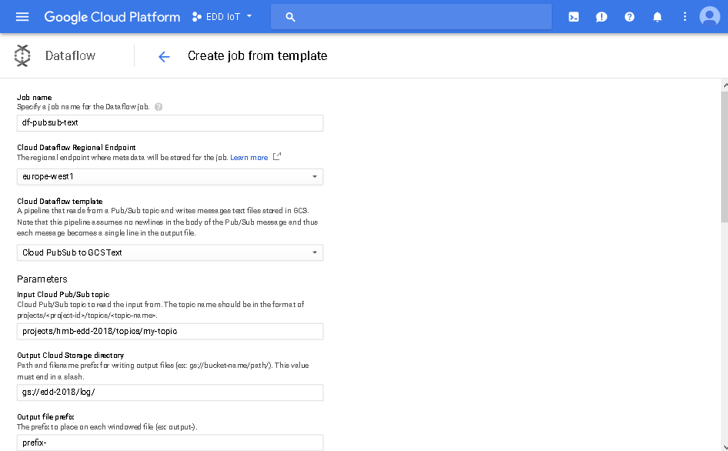
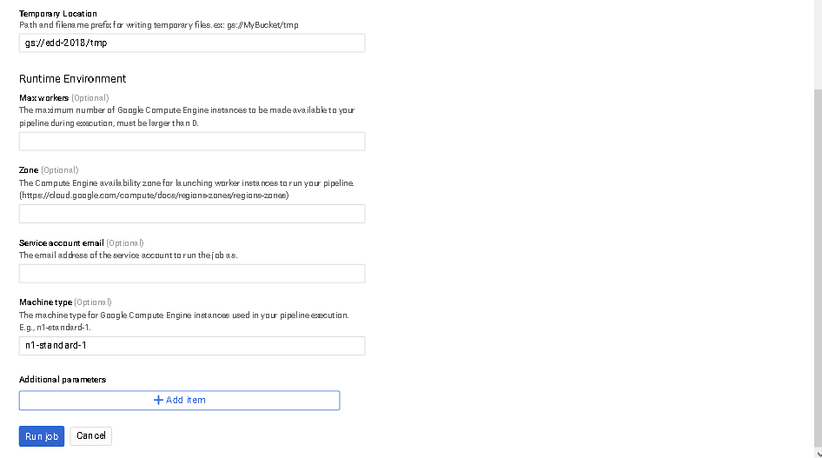
Google Cloud IoT Core
Configuration – Dataflow – Cloud PubSub to GCS Text
Create the bucket previously

Slide 19
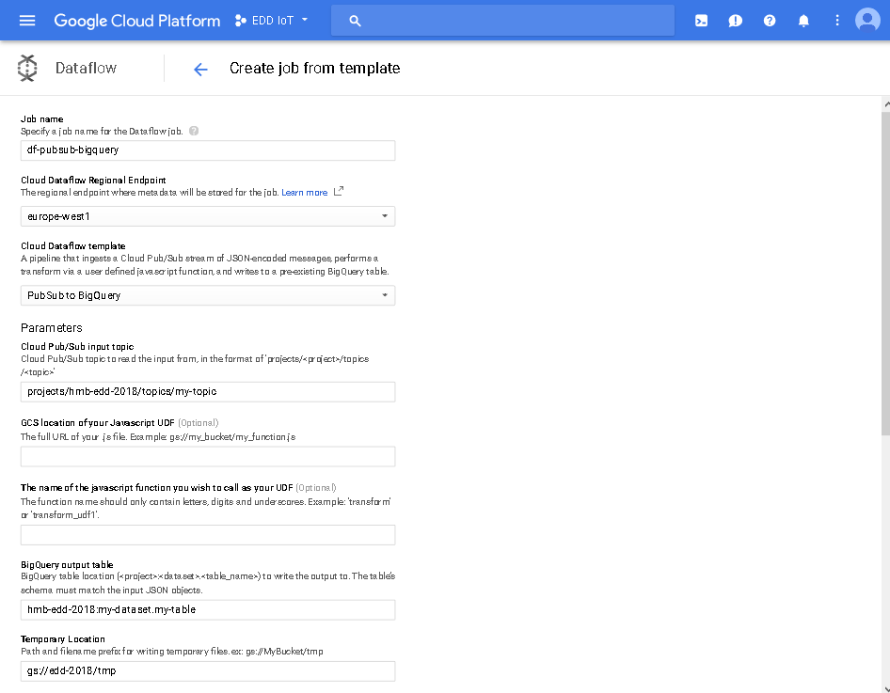
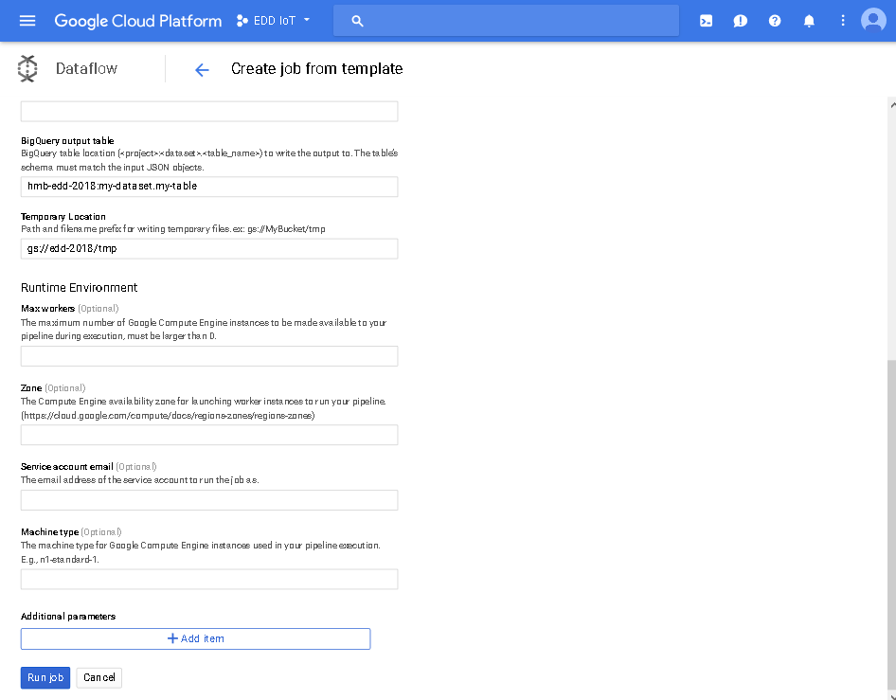
Google Cloud IoT Core
Configuration – Dataflow – PubSub to BigQuery
Create the table previously
Create the bucket previously

Slide 20
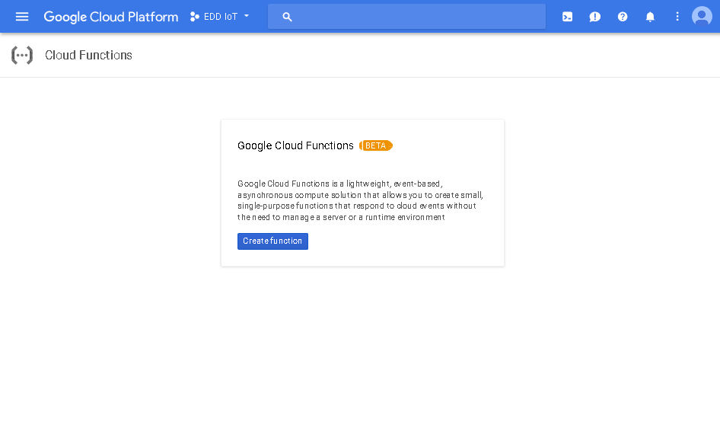
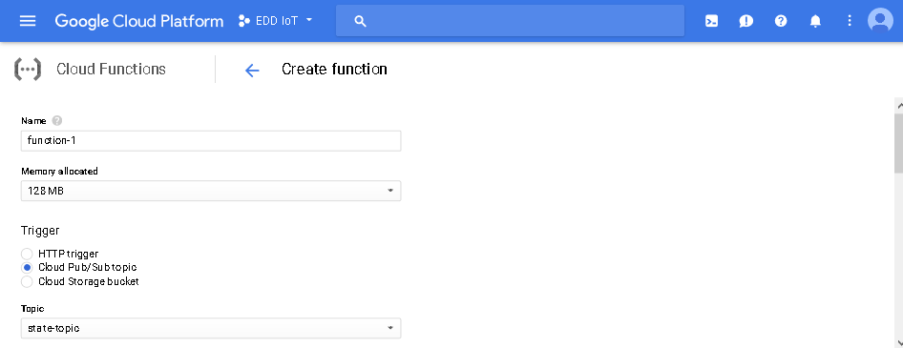
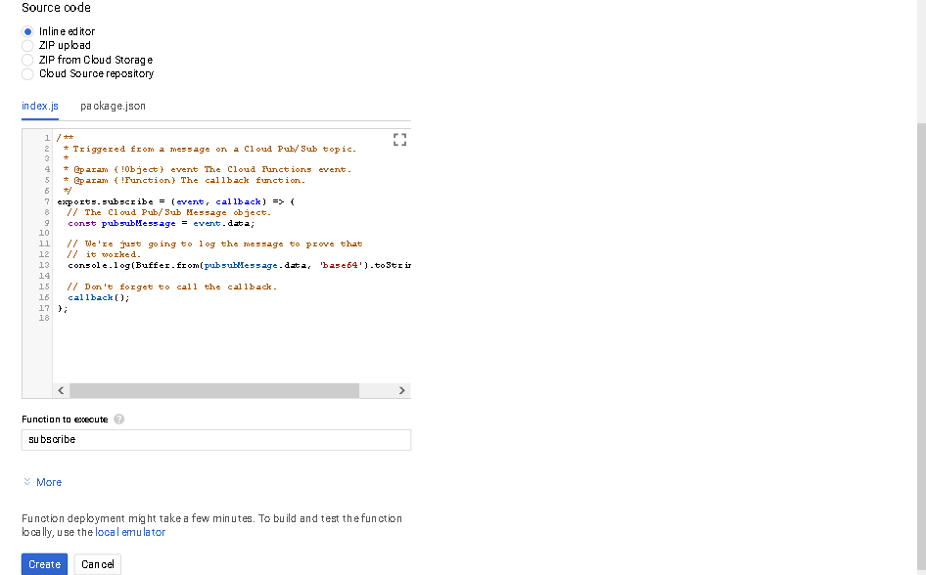
Google Cloud IoT Core
Configuration – Cloud Functions

Slide 21
Google IoT Services
Communications

Slide 22
Google Cloud IoT Core
Communications – Mosquitto Client - Publisher
pi@raspi3:~/google-iot-core $ mosquitto_pub -d -h mqtt.googleapis.com -p 8883 -q 0 -t /devices/device-id-1/state -i projects/edd-2018/locations/europe-west1/registries/thermostat/devices/device-id-1 -u unused -P `jwtgen -a RS256 -p rsa_private.pem -c aud=edd-2018 -e 3600` --cert rsa_cert.pem --key rsa_private.pem --cafile roots.pem --tls-version tlsv1.2 -V mqttv311 -m ‘{ "hvac_setpoint": 15, "state": "off" }’
Option | Meaning
-d | Enable debug messages.
-h | Specify the host to connect to.
-p | Connect to the port specified instead of the default 1883.
-q | Specify the quality of service to use for the message, from 0, 1 and 2. Defaults to 0.
-t | The MQTT topic on which to publish the message.
-i | The id to use for this client.
-u | Provide a username to be used for authenticating with the broker.
-P | Provide a password to be used for authenticating with the broker.
Option | Meaning
--cert | Define the path to a file containing a PEM encoded certificate for this client
--key | Define the path to a file containing a PEM encoded private key for this client
--cafile | Define the path to a file containing PEM encoded CA certificates that are trusted.
--tls-version | Choose which TLS protocol version to use when communicating with the broker. Must be tlsv1.2
-V | Specify which version of the MQTT protocol should be used when connecting to the remote broker. Must be mqttv311
-m | Send a single message from the command line.

Slide 23
Google Cloud IoT Core
Communications – Mosquitto Client - Subscriber
pi@raspi3:~/google-iot-core $ mosquitto_sub -d -h mqtt.googleapis.com -p 8883 -q 0 -t /devices/device-id-1/config -i projects/edd-2018/locations/europe-west1/registries/thermostat/devices/device-id-1 -u unused -P `jwtgen -a RS256 -p rsa_private.pem -c aud=edd-2018 -e 3600` --cert rsa_cert.pem --key rsa_private.pem --cafile roots.pem --tls-version tlsv1.2 -V mqttv311
Option | Meaning
-d | Enable debug messages.
-h | Specify the host to connect to.
-p | Connect to the port specified instead of the default 1883.
-q | Specify the quality of service to use for the message, from 0, 1 and 2. Defaults to 0.
-t | The MQTT topic to subscribe to.
-i | The id to use for this client.
-u | Provide a username to be used for authenticating with the broker.
-P | Provide a password to be used for authenticating with the broker.
Option | Meaning
--cert | Define the path to a file containing a PEM encoded certificate for this client
--key | Define the path to a file containing a PEM encoded private key for this client
--cafile | Define the path to a file containing PEM encoded CA certificates that are trusted.
--tls-version | Choose which TLS protocol version to use when communicating with the broker. Must be tlsv1.2
-V | Specify which version of the MQTT protocol should be used when connecting to the remote broker. Must be mqttv311

Slide 24
Google IoT Services
Conclusion

Slide 25
- Internet of Things Services
Conclusion
Pros
Strong security communications schema
Large ecosystem of cloud services
Flexibility to use the service
Cons
Force to use strong security
Topics to publish and subscribe are fixed
Cloud functions must be programmed in JS
Service cost estimation is very complex
Lack of documentation and examples

Slide 26
Google IoT Services
Links & References

Slide 27
- Internet of Things Services
Links & References
Overview of Internet of Things [https://cloud.google.com/solutions/iot-overview]
Google Cloud IoT Mainpage [https://cloud.google.com/solutions/iot/]
Google Cloud IoT Core Documentation [https://cloud.google.com/iot/docs/]
Google Partners IoT Development Kits [https://cloud.google.com/solutions/iot/kit/]
Announcing Cloud IoT Core public beta (September 27, 2017) [https://cloudplatform.googleblog.com/2017/09/announcing-Cloud-IoT-Core-public-beta.html]

Slide 28
Thank you!
Hernán Bartoletti

